Slide 1
Multi-level genomic models for earlier cancer detection
OncDS
14th August, 2019

Slide 2
The NIBR OncDS and Next Generation Diagnostics Groups
Clinical trials
Elucidating the molecular basis of therapeutic response for individual cancer patients
Technology and Methods Development
Cutting-edge DNA and RNA sequencing assays
Bioinformatics

Slide 3
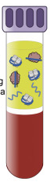
Multi-level genomic models for earlier cancer detection
Problem statement
Earlier detection of cancer increases the opportunities for curative intervention. However, early detection cancer using cell-free DNA (cfDNA) faces two main challenges: a need for high sensitivity and specificity for detection of rare tumor-derived DNA in a background of normal-derived DNA.
Many levels of information may be derived from cfDNA analyses: somatic mutations, clonal hematopoiesis, chromosomal alterations, and nucleosome positioning.
However, tools to integrate these signals to accurately classify the presence or absence of ctDNA are still needed.
Value proposition
The team will develop and test machine learning classifiers to predict the presence or absence of tumor DNA in cfDNA by using multi-level genomic information obtained from sequencing of plasma samples.
In doing so, the team challenges will be to determine:
Whether fragmentation pattern analyses can be applied to targeted gene panels.
The boundary conditions required for accurate classification of tumor-positive samples (in both real world and contrived data sets)
NIBR associates:
Alejandro Balbin – alejandro.balbin@novartis.com
Rebecca Leary – rebecca.leary@novartis.com
Katie D’Aco – katie.daco@novartis.com
Markus Riester – markus.riester@novartis.com
Ben Gustafson – ben.gustafson@novartis.com

Slide 4
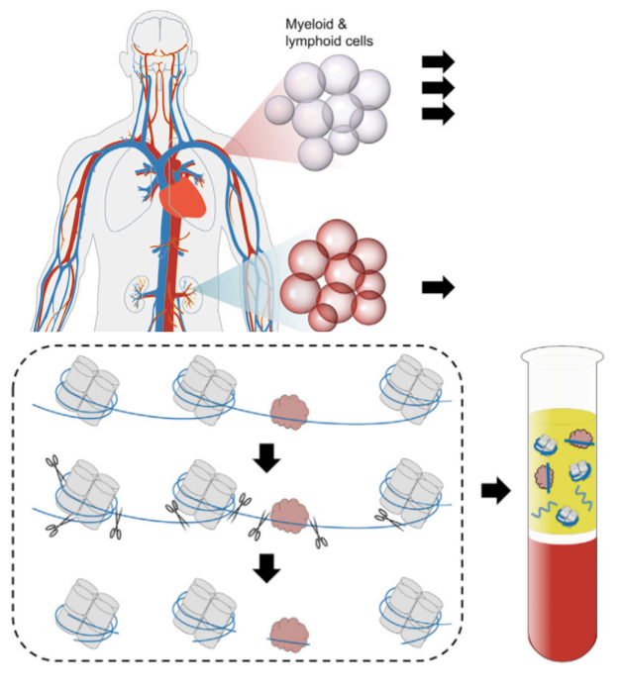
Liquid biopsies: Tumor DNA Detection and Quantification
Tumors and hematopoietic cells undergoing apoptosis shed DNA fragments into circulation
Detection of tumor DNA via non-invasive biopsies challenging in the large pool of mostly normal DNA
Sequencing to ultra high depth (>1000X) results in acceptable detection rates in late stage disease only
Single nucleotide mutation and indel detection
Copy number quantification
Purity estimation and TMB
Translocation identification
For early detection of disease or recurrence, more sensitive methods necessary
Source: M.W. Snyder, M. Kircher, A.J. Hill, R.M. Daza, J. Shendure Cell-free DNA comprises an in vivo nucleosome footprint that informs its tissues-of-origin Cell, 164 (2016), pp. 57-68
Notes:
So as we all know, during cell death, DNA not within a membrane is shed into the bloodstream. Under normal conditions most of the DNA comes from apoptosis of blood cells. In some conditions including cancer, the quantity of cfDNA in circulation increases, but against the background of fragments from normal cells it forms a small minority.
Cancer in late-stage disease can be detected with ultra-high sequencing. But for ealier detection, more sensitive methods are necessary.

Slide 5
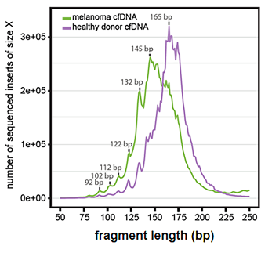
DNA fragment lengths indicate tumor or normal cellular origin
Increased quantity of cell-free DNA in the circulation associated with malignant solid tumors
Subtle but distinct differences in fragment length between normal cell-free DNA and ctDNA from a variety of solid tumors
ctDNA overall consistently shorter than the fragment length of normal cell-free DNA
Source: Underhill HR, Kitzman JO, Hellwig S, Welker NC, Daza R, Baker DN, et al. (2016)
Fragment Length of Circulating Tumor DNA
PLoS Genet 12(7): e1006162. https://doi.org/10.1371/journal.pgen.1006162
Cristiano, S et al (2019). Nature, 570: 385
Notes:
The paper Fragment Length of Circulating Tumor DNA from Jay Shendure’s lab was one of the early papers to note a difference in the fragment length distribution of circulating tumor DNA vs normal.
They found in cell-free DNA from melanoma patients that fragments occurred more commonly at a shorter fragment length than those from healthy donors (132–145 bp vs. 165 bp, respectively). So as illustrated in the plot here, we can see the dominant peaks of 132 and 145bp for the melanoma samples vs. 165bp for the healthy donor’s DNA. The 165bp length corresponds to the length of the DNA wrapped around a nucleosome plus a linker.
The mechanism for how the shorter fragments are created are not completely understood. One hypothesis is that tissue-specific differences in nucleosome wrapping result in fragment lengths that differ between hematopoietic cells and other tissue.

Slide 6
Fragmentation patterns provide genome wide scale information about tumor, normal and tissues of origin
Window Protection Score: quantifies length of fragments clustering around sliding 120bp window
Correlates with the locations of nucleosomes within strongly positioned arrays
Correlates with genomic features such as DHS sites and transcription start sites
Genome wide fragmentation profiles: As the ratio of short to long fragments
Source: M.W. Snyder, M. Kircher, A.J. Hill, R.M. Daza, J. Shendure Cell-free DNA comprises an in vivo nucleosome footprint that informs its tissues-of-origin Cell, 164 (2016), pp. 57-68
Cristiano, S et al (2019). Genome wide cell free DNA fragmentation in patients with cancer. Nature, 570: 385
Notes:
They proposed a metric for quantifying fragment length and position, called Windowed Protection Score. It is a sliding 120bp window counting the number of fragments with an endpoint within the window vs. having both ends outside the window. By this metric, sequences with shorter fragments predominating will tend to have a lower overall WPS than sequences with longer fragments.
Looking at the cartoon to right here, we see a periodicity in the WPS plotted here, with the lower WPS scores correlating with the locations of nucleosomes and other genomic features such as TSS.

Slide 7
Challenges of current approaches in the clinical setting
Fragmentation pattern approaches were developed for WGS, while small targeted panels are used in the clinic.
Identifying most informative regions in the genome is vital
Current methods are not reliable on detecting plasma samples with < 5% ctDNA.
Samples > 20% ctDNA are relatively ”easy” to detect in main tumor indications
Methods that integrate different levels of genomic information are still needed.
SNV, indels, CNVs and fragmentation patterns, other.

Slide 8
Datasets available
Publicly available datasets
Internal available datasets
Fragmentation pattern analysis
Low pass WGS (N ~ 400)
Matched WXS subset of patients.
Classification of samples with < 5% ctDNA
Summarized window protection score for deep sequencing targeted gene panel (N genes ~600)
N Clinical samples ~2000
Curated calculated tumor purity for these samples.
Optionally: Summarized information with cfDNA mutation frequency in cancer and clonal hematopoiesis genes
Optionally: Novartis associates might run developed algorithms on PanCancer se to generate comparable data.

